Slide 1



Economy Growth & Trade Analysis
Presented by Ahmed Hatem

Slide 2

Project Agenda
Introduction
Data Preparation
Questions
Story
KPIs
Dashboards

Slide 3

Introduction
In this analysis, we delve into the economic performance and trade dynamics of two prominent European countries, Spain and Germany.
By examining a range of indicators from the World Data Bank, we aim to uncover insights into their GDP growth, trade activities, and economic resilience over time.
The reason behind this analysis is to answer some questions regarding whether to invest in this country or not.

Slide 4
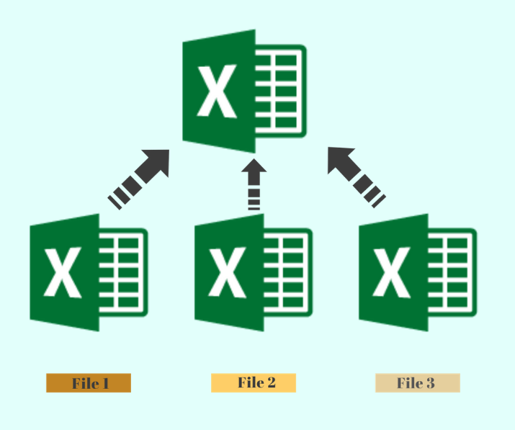
Data Preparation
The dataset is from world databank
I used 2 datasets and joined them
Some of the Indicators Used:
Annual GDP %
Trade % of GDP
Gross Savings % of GDP
Merchandise Imports & Exports
Fuel Imports & Exports % of Merchandise
I used calculated fields to calculate the merchandise export to import ratio.

Slide 5

Questions
Which country has higher annual GDP Growth Rate?
Which country has higher merchandise export to import ratio?
Which country has the higher trade % of GDP?
How is the fuel trade for both countries?
Which country has higher gross savings / year?
What is the average reserves of imports %?

Slide 6
Story Architecture
Third Dashboard
Merchandise
First Dashboard:
Understanding the Economy
Second Dashboard:
Imports & Exports
Fourth Dashboard
Savings & Reserves

Slide 7

KPIs
The KPI "Merchandise Trade (% of GDP)" is a measure that represents the total value of a country's merchandise exports and imports as a percentage of its Gross Domestic Product (GDP). It provides insight into the importance of international trade in relation to the size of the country's economy.

Slide 8
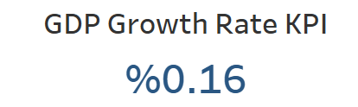
KPIs
The GDP growth rate is a key performance indicator (KPI) that measures the percentage change in a country's Gross Domestic Product (GDP) from one period to another, typically on an annual basis. It is a fundamental metric used to assess the health and direction of an economy over time.

Slide 9
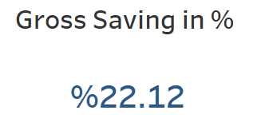
KPIs
The Gross Saving % of GDP is a key economic indicator that measures the proportion of total gross savings to Gross Domestic Product (GDP). It provides insights into the level of savings within an economy relative to its overall economic output.

Slide 10
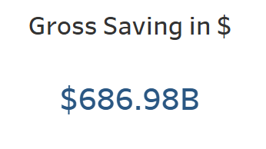
KPIs
The Gross Saving in $ represents the total amount of savings within an economy, typically measured in current US dollars. It is a key economic indicator that reflects the total amount of funds available for investment, both by the private sector and the government.

Slide 11
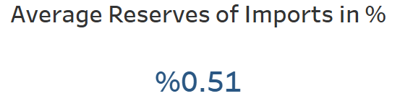
KPIs
The "Average Reserves of Imports %" is a measure that represents the average number of months a country's reserves can cover its imports. It provides insight into a country's ability to sustain its import levels using its foreign reserves.

Slide 12
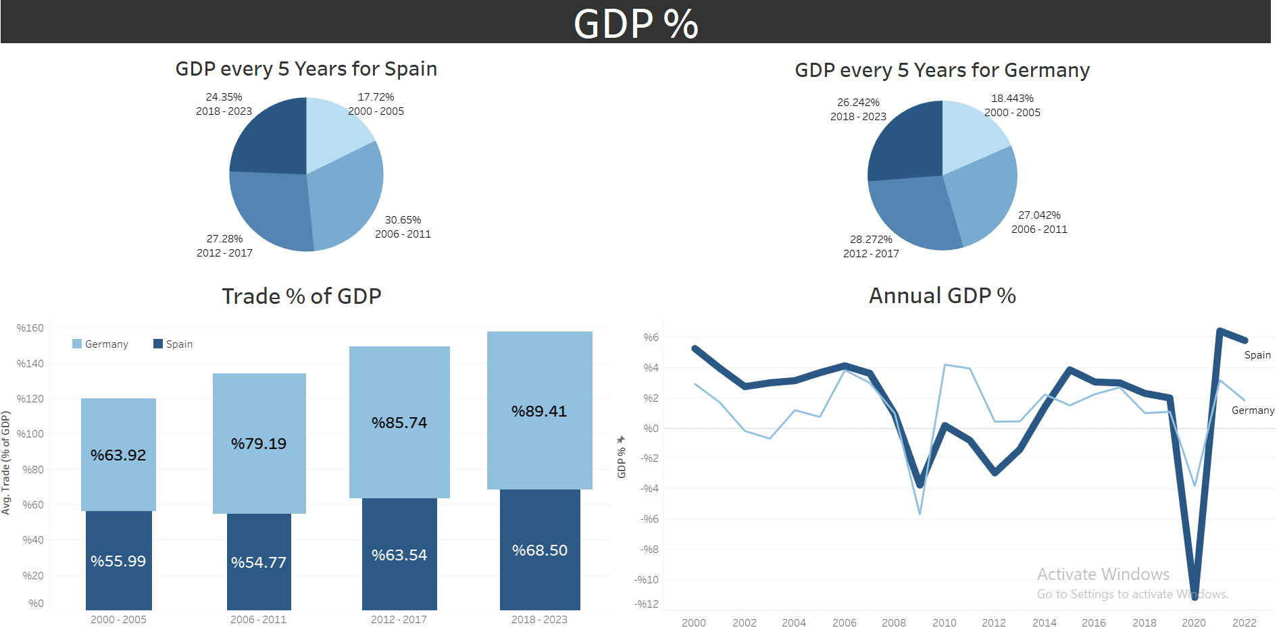
First Dashboard

Slide 13
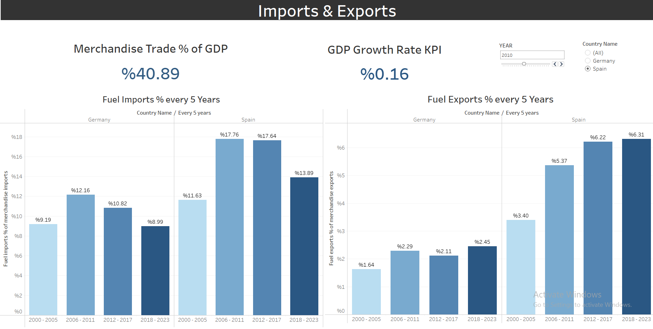
Second Dashboard

Slide 14
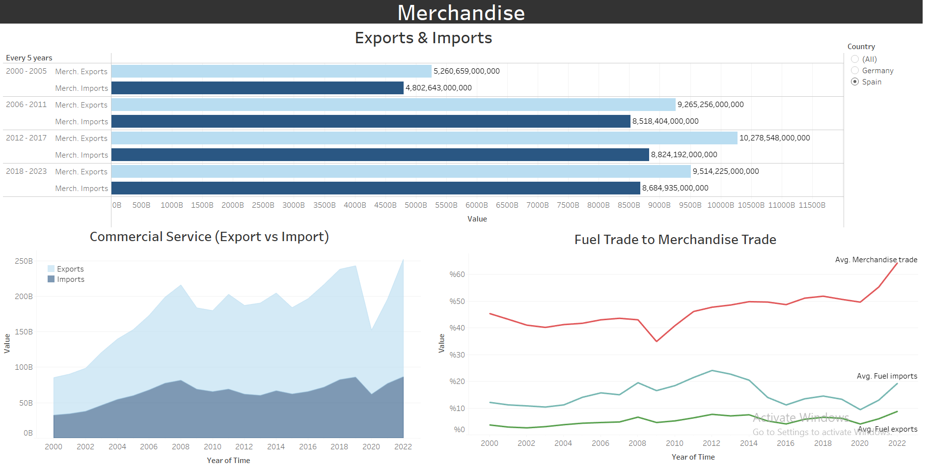
Third Dashboard

Slide 15
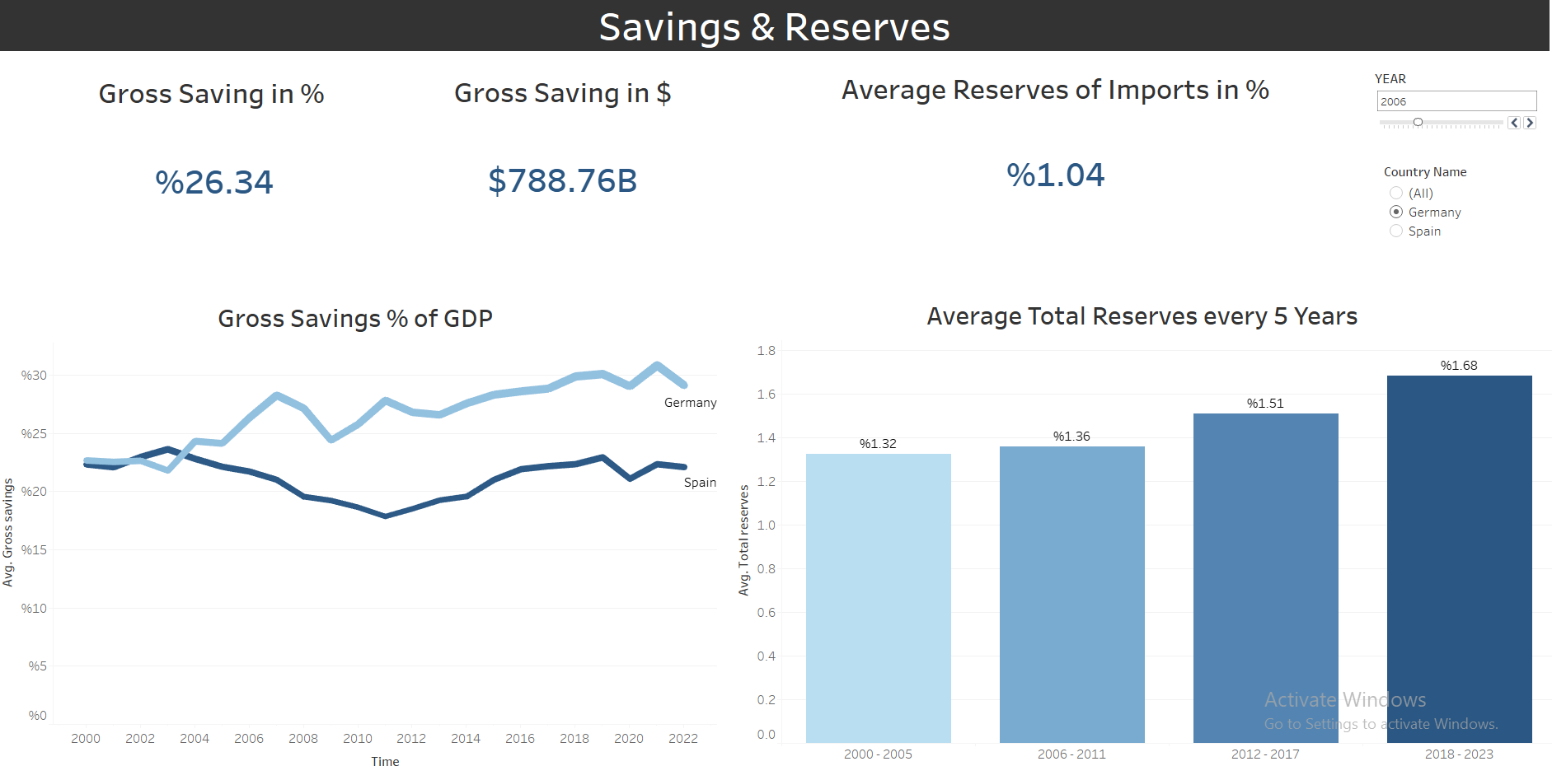
Fourth Dashboard

Slide 16

Recommendation

Slide 17

Thank you

